Slide 1

Applied Analytics Capstone

Slide 2
Agenda
Background
Objectives Methodology Variables Findings
Recommendations

Slide 3
Background
Nuveen, formerly Nuveen Investments, a subsidiary of TIAA, is an American global investment manager
Nuveen is one of the largest investment managers in the world with $1.1 trillion in assets under management
Nuveen offers a range of investment capabilities across income, equities, alternatives and multi-asset solutions

Slide 4
Objectives
Data Provided
Dataset contains 36 months of data; may use data from December 2012 to November 2019 to predict the next 12 months
Goal: Develop a series of models that predict sales 12 months into the future to help acquire new customers while developing and retaining existing customers
Determine how many models need to be
used and what the groups are
Determine best technique

Slide 5
Methodology
Run a Regression Analysis: Validate using Testing Data
Analyze and Understand Data
Clean Data and Manage Outliers
Create Indepen- dent Variables
Divide Data into Modeling Groups
Separate into Testing and Training Datasets
Use to make Final Recomme- ndations
Create Lift Chart for each Model

Slide 6
Decision Tree
~Based on 2019 Sales~
10,010 Sales Representatives
Sales below
$300,000
8,974 Sales Reps
Sales $300,000+
1,036 Sales Reps
Model 3
Sales below
$30,000
7,326 Sales Reps
Sales $30,000-
$299,999
1,648 Sales Reps
Model 1
Model 2

Slide 7
Model 1
12 Month Sales up to November 2019 less than
$30,000
73.2% of
Advisors

Slide 8
Model 1- Positive Influencers
Independent Variable
Assets under management in target funds of Nov. 2019
12-month sales up to November 2018
Number of asset classes sold up to November 2019 for at least $1

Slide 9
Model 1- Negative Influencers
Independent Variables
Assets under management in target funds of Nov. 2018

Slide 10


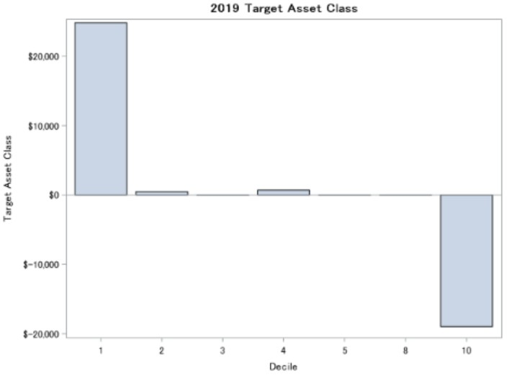
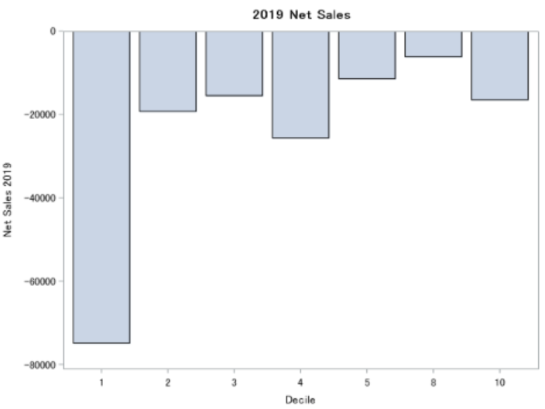
Model 1 - Variables
Advisors in decile 1 manage more Target Fund Assets and advisors in decile 10 are losing assets in 2019
Advisors in decile 1 had much more negative net sales in 2019

Slide 11
Model 1- Lift Chart
Decile | Number of Advisors | Actual Sales Per Advisor | Lift Over Average | Cumulative No. Of Advisors | Cumulative Sales per Advisor | Cumulative Lift
1 | 366 | $119,277.44 | 179% | 366 | $119,277 | 179%
2 | 366 | $45,489.03 | 6% | 732 | $82,383 | 93%
3 | 435 | $35,941.56 | -16% | 1,167 | $65,072 | 52%
4 | 298 | $46,336.65 | 8% | 1,465 | $61,261 | 43%
5 | 88 | $30,699.81 | -28% | 1,553 | $59,529 | 39%
6 | 2,106 | $30,420.16 | -29% | 3,659 | $42,775 | 0%
7 | 4 | $4,186.43 | -90% | 3,663 | $42,733 | 0%
Total | 3,663 | $42,732.90 | 0%

Slide 12
Model 2
12 Month Sales up to November 2019 between $30,000 and $300,000
16.5% of
Advisors

Slide 13
Model 2- Positive Influencers
Independent Variables
12-month sales up to November 2018
Assets under management in target funds of Nov. 2019

Slide 14
Model 2- Negative Influencers
Independent Variable
Assets under management in target funds of Nov. 2018
Number of asset classes sold up to November 2019 for at least $1

Slide 15


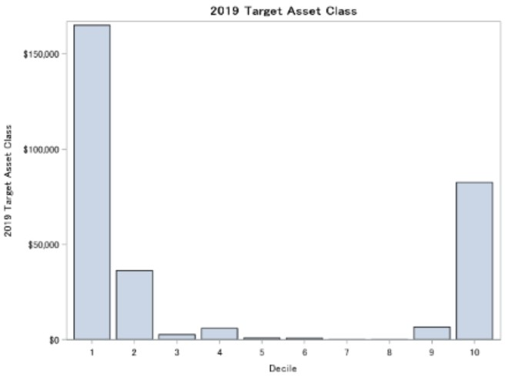
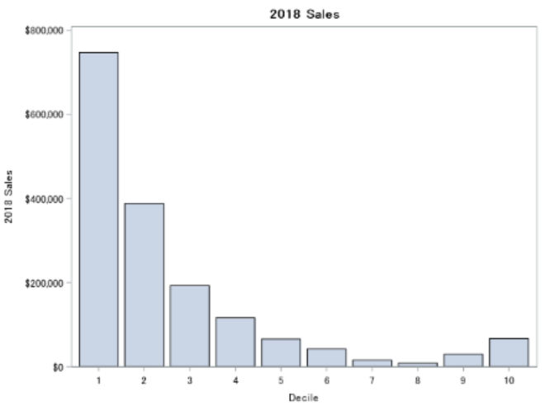
Model 2 - Variables
Advisors in deciles 1 manage more Target Fund Assets in 2019
Advisors in decile 1 and 2 had much higher Sales in 2018

Slide 16
Model 2 – Lift Chart
Decile | Number of Advisors | Actual Sales Per Advisor | Lift Over Average | Cumulative No. Of Advisors | Cumulative Sales per Advisor | Cumulative Lift
1 | 82 | $341,821.52 | 84% | 82 | $341,822 | 84%
2 | 82 | $186,544.00 | 0% | 164 | $264,183 | 42%
3 | 83 | $153,121.06 | -18% | 247 | $226,862 | 22%
4 | 82 | $209,868.66 | 13% | 329 | $222,627 | 20%
5 | 83 | $114,762.64 | -38% | 412 | $200,897 | 8%
6 | 82 | $148,791.15 | -20% | 494 | $192,248 | 3%
7 | 38 | $58,677.94 | -68% | 532 | $182,707 | -2%
8 | 127 | $217,698.38 | 17% | 659 | $189,451 | 2%
9 | 83 | $176,247.00 | -5% | 742 | $187,974 | 1%
10 | 82 | $170,777.79 | -8% | 824 | $186,262 | 0%
Total | 824 | $186,262.33 | 0%

Slide 17
Model 3
12 Month Sales up to November 2019 greater than $300,000
10.3% of
Advisors

Slide 18
Model 3- Positive Influencers
Independent Variables
12-month sales up to November 2018
Assets under management in target funds of Nov. 2018
Assets under management in target funds of Nov. 2019
Number of asset classes sold up to November 2019 for at least $1

Slide 19


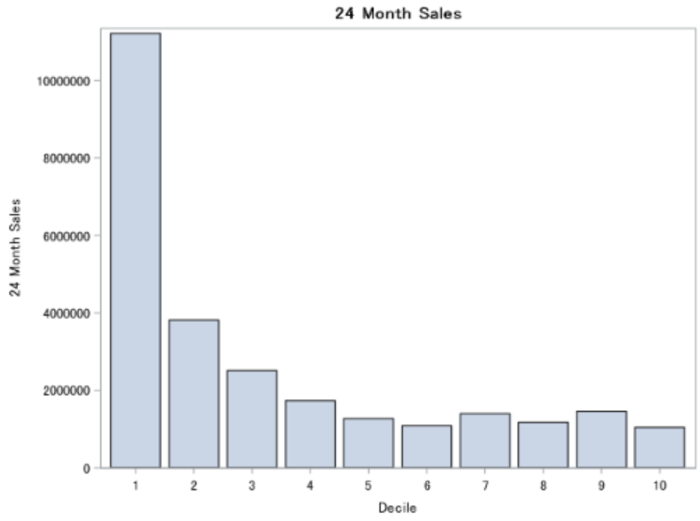
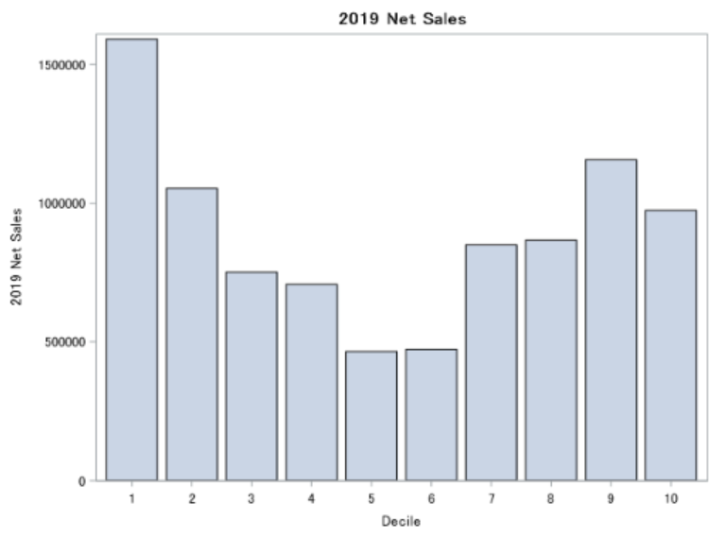
Model 3 - Variables
Advisors in decile 1 have much more Sales over the 24-month period
Advisors in decile 1 had much higher Net Sales in 2019

Slide 20
Model 3 – Lift Chart
Decile | Number of Advisors | Actual Sales Per Advisor | Lift Over Aver age | Cumulative No. Of Advisors | Cumulative Sales per Advisor | Cumulative Lift
1 | 51 | $3,453,406.21 | 175% | 51 | $3,453,406 | 175%
2 | 52 | $2,509,933.09 | 100% | 103 | $2,977,090 | 137%
3 | 52 | $2,358,487.66 | 88% | 155 | $2,769,559 | 120%
4 | 52 | $688,445.47 | -45% | 207 | $2,246,767 | 79%
5 | 51 | $766,560.12 | -39% | 258 | $1,954,168 | 56%
6 | 52 | $778,235.39 | -38% | 310 | $1,756,915 | 40%
7 | 52 | $709,016.03 | -44% | 362 | $1,606,388 | 28%
8 | 52 | $655,366.21 | -48% | 414 | $1,486,936 | 18%
9 | 52 | $347,083.93 | -72% | 466 | $1,359,742 | 8%
10 | 51 | $311,535.04 | -75% | 517 | $1,256,341 | 0%
Total | 517 | $1,256,340.61 | 0%

Slide 21
Recommendations
Decile 1 in Model 2
Deciles 1-10 in Model 3
In-person Visit
If prioritizing advisors expected
to make over $300,000 in sales
If prioritizing advisors expected
to make between $30,000 and
$299,999 in sales
Deciles 1-5 in Model 1
Deciles 2-10 in Model 2
Phone Call
If prioritizing advisors expected to make below $30,000 in sales
Decile 9 in Model 1
Email

Slide 22
Thank you!

Slide 23
Appendix

Slide 24
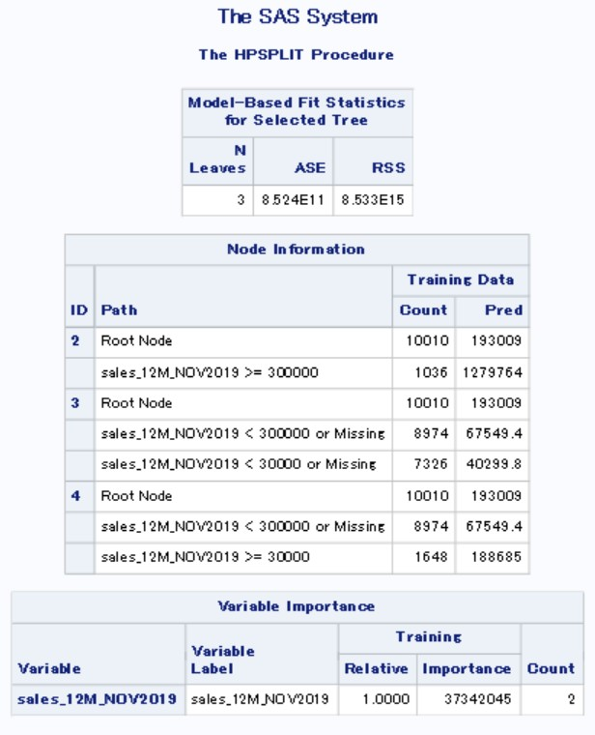
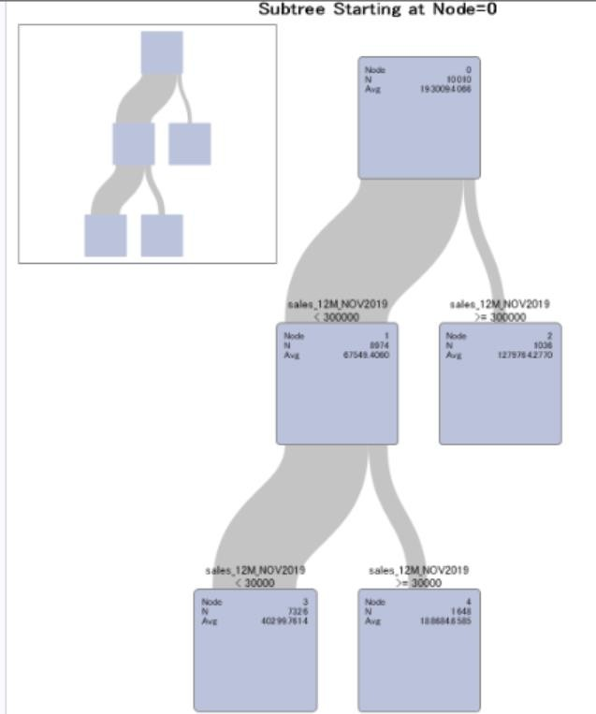
Decision Tree

Slide 25
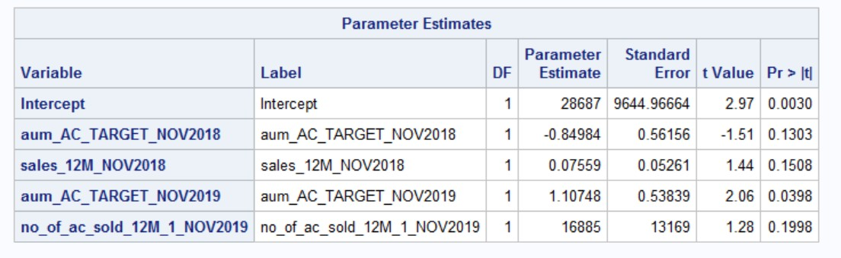
Model 1 (Nuveenlow)

Slide 26
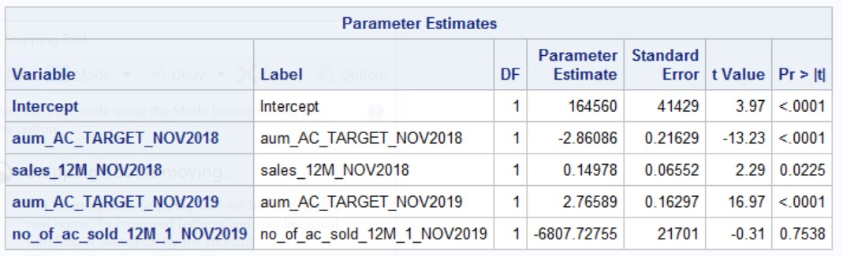
Model 2 (Nuveenmiddle)

Slide 27
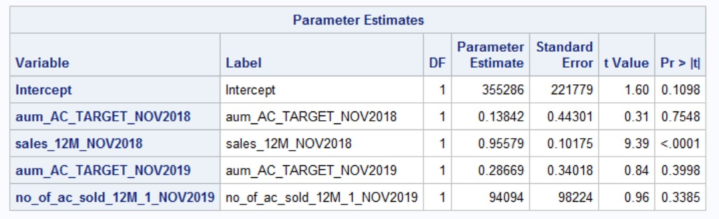
Model 3 (Nuveenhigh)

